Slide 1
IOT BASED SMART IRRIGATION SYSTEM
- ABISHEK a L

Slide 2
BLOCK DIAGRAM

Slide 3
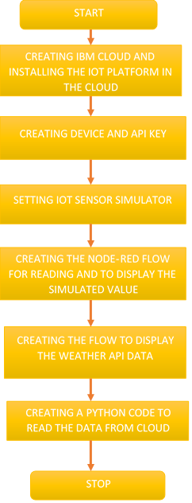
steps

Slide 4
links
YouTube link: https://youtu.be/EvaVwRJkNdA
GitHub link: https://github.com/SmartPracticeschool/llSPS-INT-2322-Smart-Agriculture-system-based-on-IoT

